Slide 1
GUI_Final Report
Wendy Chao

Slide 2
Project Definition
The idea of DIAG Test Tool with GUI comes from DAT (DIAG auto test tool). In the end, the tool should behave like a silicon test platform which
Support different chips
Support different testing scenario
Automatic tests
Easy to use
Platform
Windows 7 / Windows 10

Slide 3
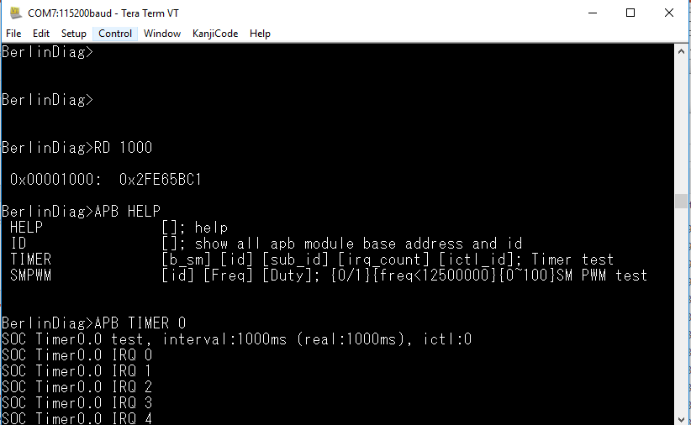
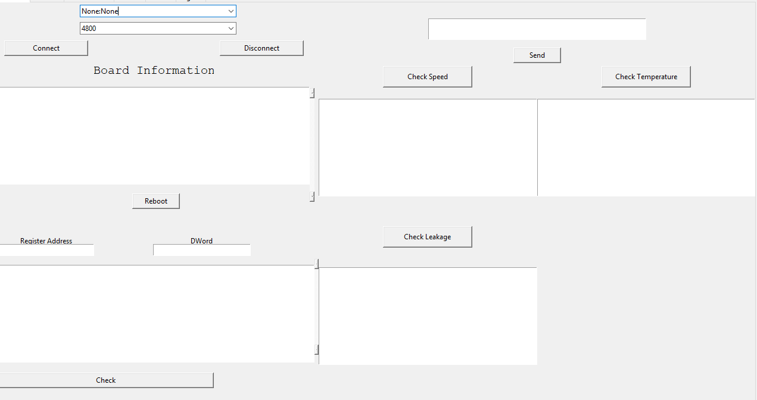
<Why GUI??>
No need to type complicate commands to execute task. Only one button.
Before
After

Slide 4
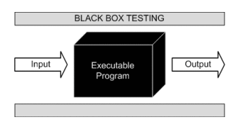
Software Quality Assurance (SQA) Testing
Software Quality Assurance evaluates the functional, performance, usability and security of the software or APP.
Functional Testing
black-box testing to unit and sanity testing.
Performance, Network & Load Testing
verify GUI from load, stress, volume and scalability.
Usability Testing
A comprehensive review of GUI, from usability, and user experience (UX), to the user interface (UI).
Platform & Device Compatibility Testing
With access to GUI over 3,000 times, ensure your software works for your users.
Cyber Security Testing
Safeguard the reputation and sensitive customer data from cyber attacks or other malicious activities.

Slide 5
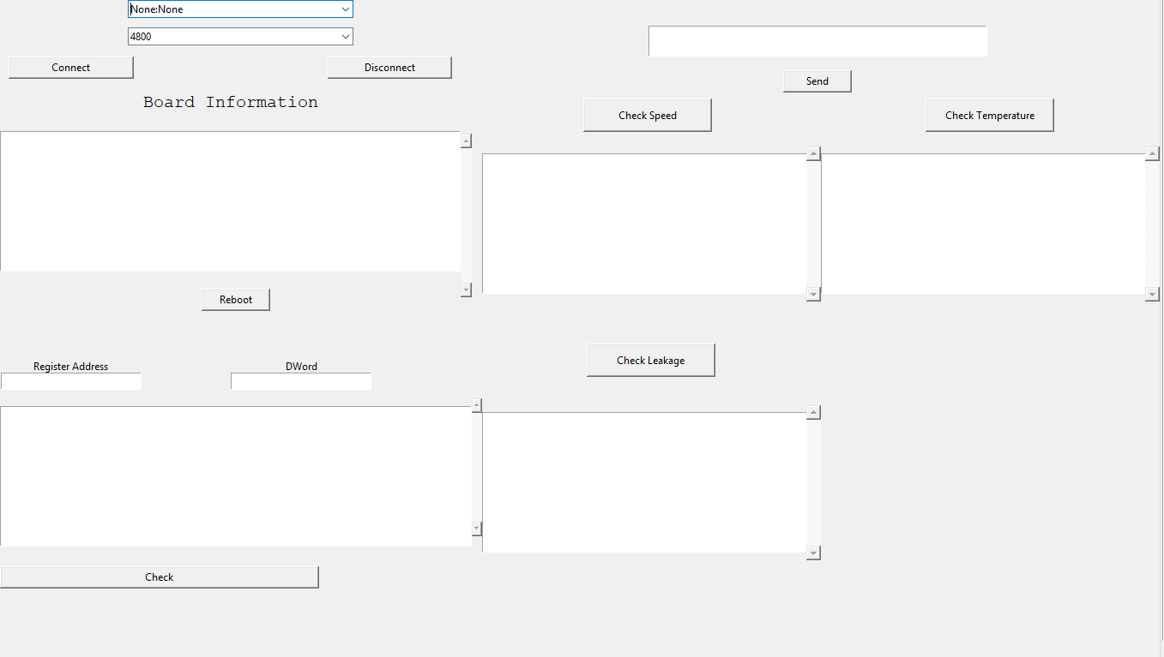
Features
1. Check board information / leakage / speed / temperature / content of register

Slide 6
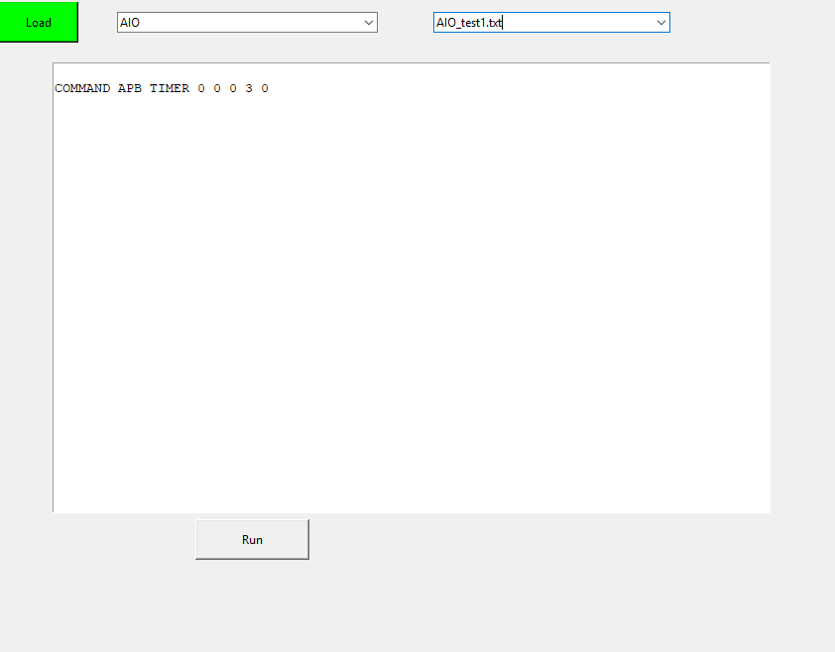
2. Choose the txt file and execute it

Slide 7
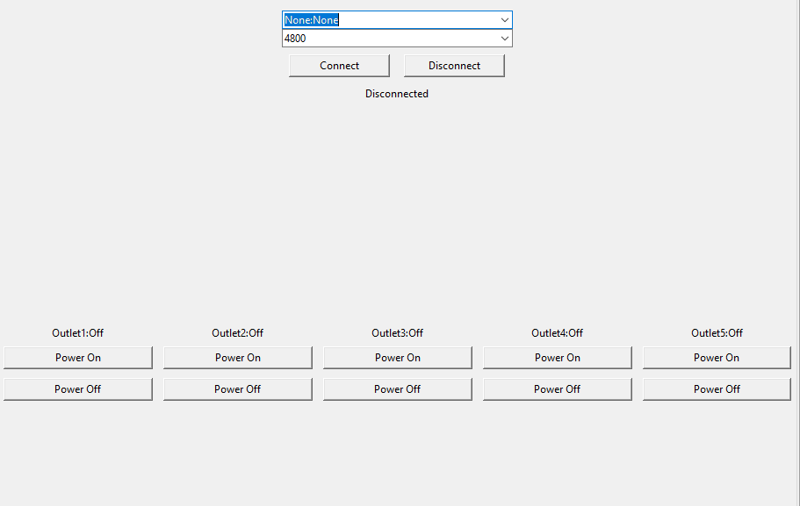
3. Doing the power switch

Slide 8
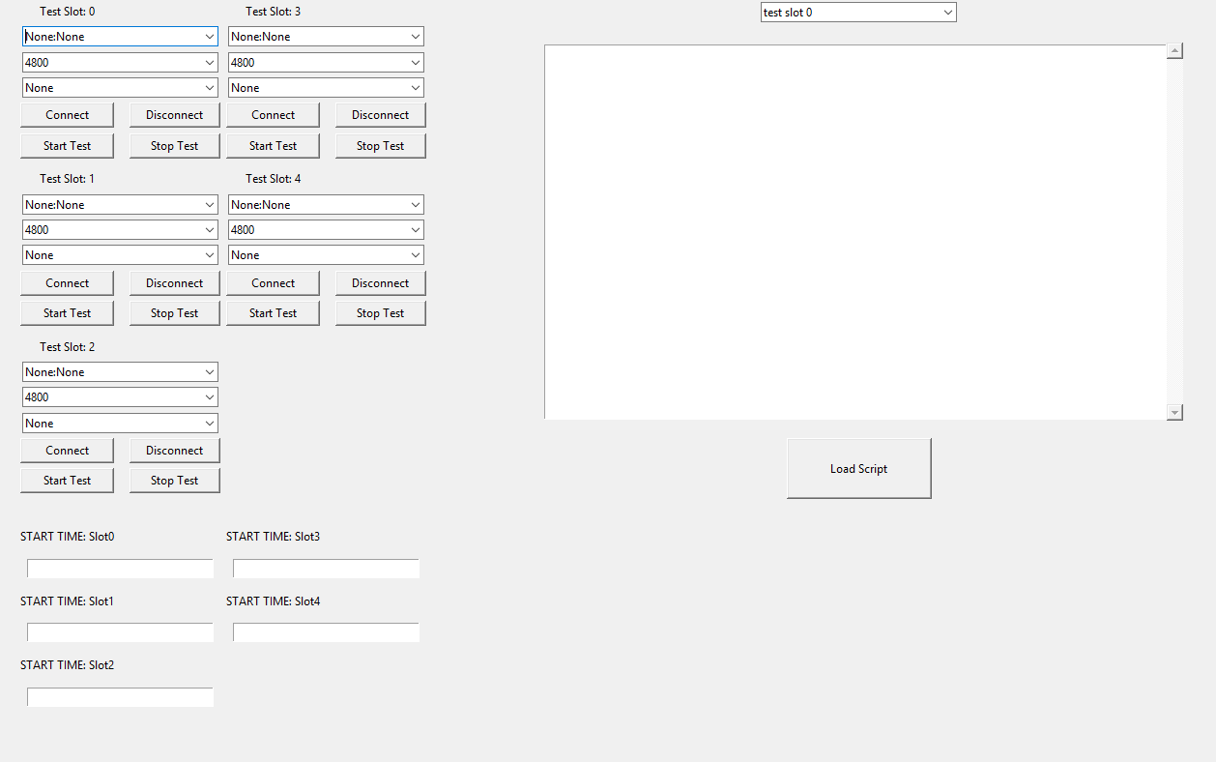
4. Execute the multiple auto tests

Slide 9
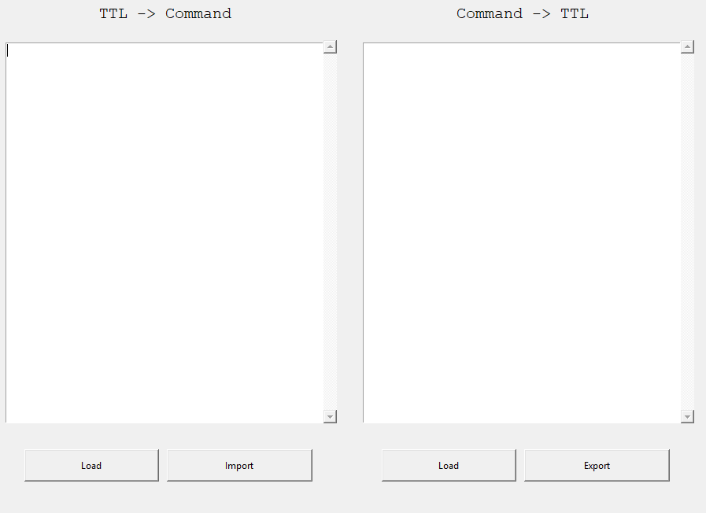
5. Transfer TTL to command or command to TTL

Slide 10
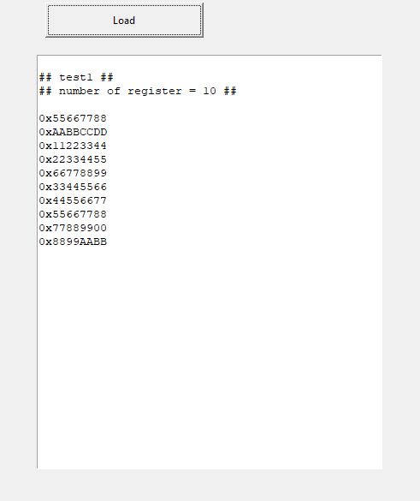
6. Check the information of register

Slide 11
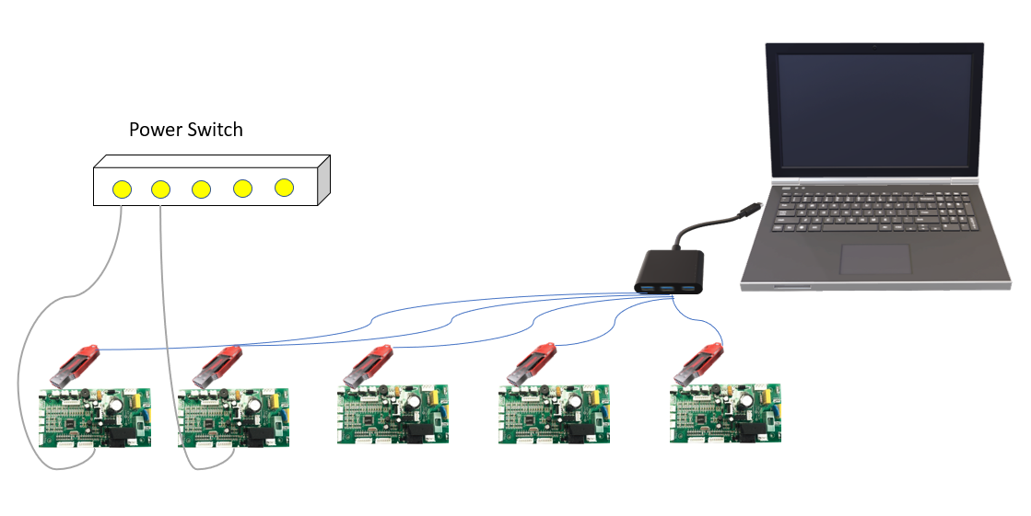
Implementation
Switch power supply automatically.
Run scripts automatically
Support multiple tests in multiple boards
TTL transfer to command
Check the content of register

Slide 12
Risk and Issue
CTRL+C will kill whole tool
Error when switch UART port
Development
Support multiple chips in the future

Slide 13
Documentation
GUI code explain.docx
GUI user guide.docx
GUI setup.docx

Slide 14
Thanks for your patience!

